Slide 1
Machine Learning Evaluation
Vera Hollink
2025

Slide 2

Summary last class

Slide 3
Decision tree induction
can fly
yes
no
legs
lays eggs
http://www.run.montefiore.ulg.ac.be/~francois/software/jaDTi/example/files/zooDT.png
< 6
≥ 6
yes
no
bird
no bird
cover
no bird
feathers
other
bird
no bird

Slide 4
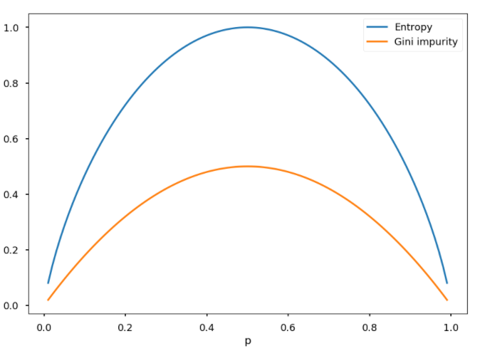
Attribute selection
$$Gini Impurity=1−\sum_{i−1}^{m}{p_{i}^{2}}$$
Gini Impurity
Information gain

Slide 5
Today
Generalizing with data
Evaluation measures
Train and test data
Statistical significance
Model optimization

Slide 6

Generalizing with Data

Slide 7
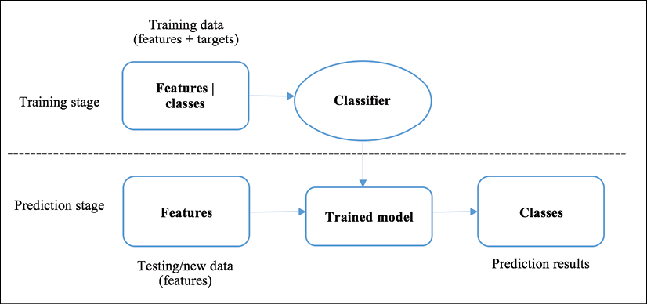
Training and using a classifier

Slide 8
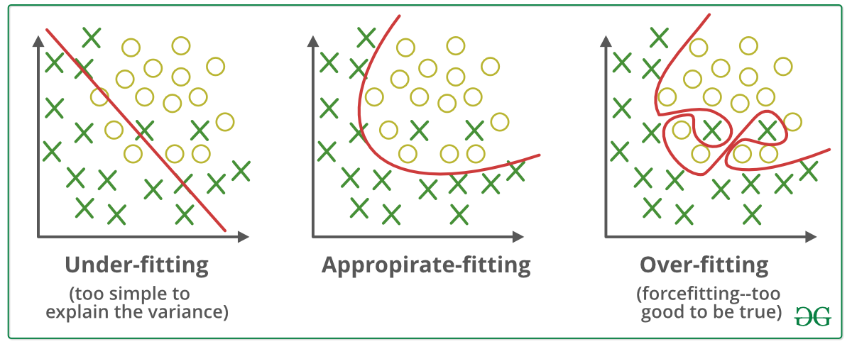
Good fit
Model trained on training set
Model generalizes well to unseen data (test set)
Good performance on training set and test set

Slide 9
Overfitting
Model trained too precisely on training set
Models random noise in training set
Very good fit on training set
Poor fit on test set

Slide 10
Underfitting
Model is too course/simple to fit the data
Poor fit on training set
Poor fit on test set

Slide 11
Evaluation
Why?
Find out if model is good enough
Find out which model is best
What?
Predictions/speed/… of the model
Predictions/speed/… difference between models
How?
Measures
Training and test data
Significance

Slide 12

Evaluation measures

Slide 13
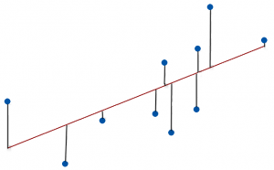
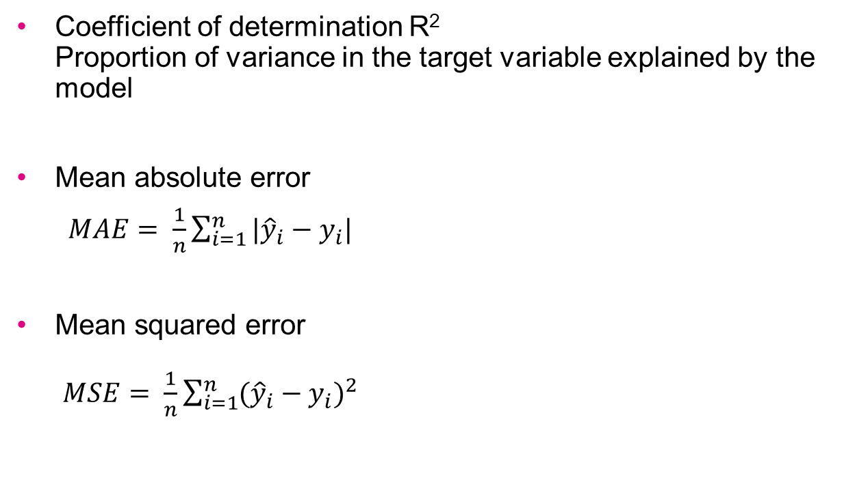
Regression evaluation measures
Coefficient of determination R² Proportion of variance in the target variable explained by the model
Mean absolute error
$MAE= \frac{1}{n}\sum_{i=1}^{n}{|{\hat{y}}_{i}−y_{i}|}$
Mean squared error $MSE= \frac{1}{n}\sum_{i=1}^{n}{{({\hat{y}}_{i}−y_{i})}^{2}}$

Slide 14
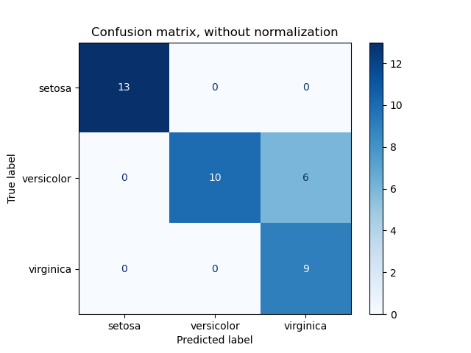
Classification evaluation: confusion matrix

Slide 15
Two classes
Two classes: T/F, Positive/Negative
 | Predicted positive | Predicted negative
Actual positive
Actual negative

Slide 16
Two classes
Two classes: T/F, Positive/Negative
 | Predicted positive | Predicted negative
Actual positive | True positives | False negatives
Actual negative | False positives | True negatives

Slide 17
Two class measures
 | Predicted positive | Predicted negative
Actual positive | TP | FN
Actual negative | FP | TN
Accuracy (TP+TN) /(P+N)
Error rate (FP+FN) / (P+N)
Precision TP / (TP + FP)
Recall TP / P
F-score (2 * precision * recall)/(precision + recall)
What if actual negative >> actual positive?
Model always predicts negative
Accuracy – balanced classes
Precision/recall/F-score – unbalanced classes
How many of the predicted positives are really positive
How many of the actual positives are recognized

Slide 18


Multi-class measures?
 | Predicted positive | Predicted negative
Actual positive | TP | FN
Actual negative | FP | TN
Accuracy (TP+TN) /(P+N)
Error rate (FP+FN) / (P+N)
Precision TP / (TP + FP)
Recall TP / P
F-score (2 * precision * recall)/(precision + recall)

Slide 19
Training and test data

Slide 20
Evaluation
Why?
What?
How?
Measures
Training and test data
Significance

Slide 21
Training and test data 1: same data for training and testing
Bad idea => why?

Slide 22
Training and test data 2: holdout / percentage split
Complete data set
x | x | x | x | x | x | x | x | x | x
Randomly select x% as test data
train | test | train | train | train | test | train | train | test | train
Risk?
Atypical test set

Slide 23
Training and test data 3: k-fold cross-validation
Complete data set
x | x | x | x | x | x | x | x | x | x
Fold 1:
test | test | train | train | train | train | train | train | train | train
Fold 2:
train | train | test | test | train | train | train | train | train | train
Fold 3:
train | train | train | train | test | test | train | train | train | train
Fold 4:
train | train | train | train | train | train | test | test | train | train
Fold 5:
train | train | train | train | train | train | train | train | test | test
Average results over folds

Slide 24
More cross-validation
Leave-one-out
n samples ➔ n-fold cross validation
For very small data sets
Stratified cross-validation
Distribution over classes in training set is the same in each fold

Slide 25

Cross-validation with scikit-learn
# import libraries
from sklearn.model_selection import cross_val_score
# initialize a model
clf = KNeighborsClassifier(n_neighbors=3)
# evaluate the model using cross-validation
scores = cross_val_score(clf, X, Y, cv=5, scoring='accuracy')
number of folds
output is array of scores for the k folds
metric to be used

Slide 26
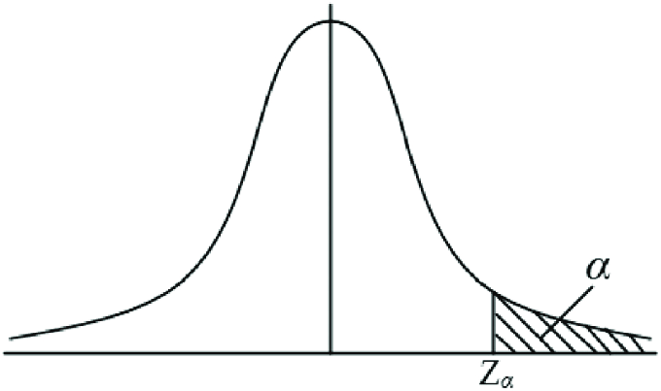
Statistical significance

Slide 27
Evaluation
Why?
What?
How?
Measures
Training and test data
Significance

Slide 28
Model M₁ significantly different from M₂?
k-fold cross-validation
k measurements per model
n=k
Hypotheses
H₀: performance M1 same as M2
H₁: performance M1 differs from M2

Slide 29
Model M₁ significantly different from M₂?
Fold | Performance M1 | Peformance M2
1 | 0.80 | 0.82
2 | 0.75 | 0.72
3 | 0.75 | 0.80
4 | 0.69 | 0.61
5 | 0.72 | 0.70
6 | 0.81 | 0.75
7 | 0.80 | 0.82
8 | 0.85 | 0.85
9 | 0.91 | 0.88
10 | 0.73 | 0.69
Mean | 0.78 | 0.76

Slide 30
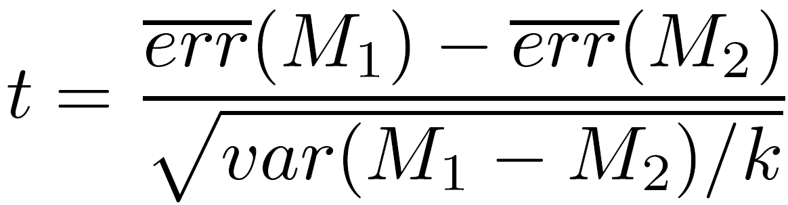
Model M₁ significantly better than M₂?
Paired t-test

Slide 31
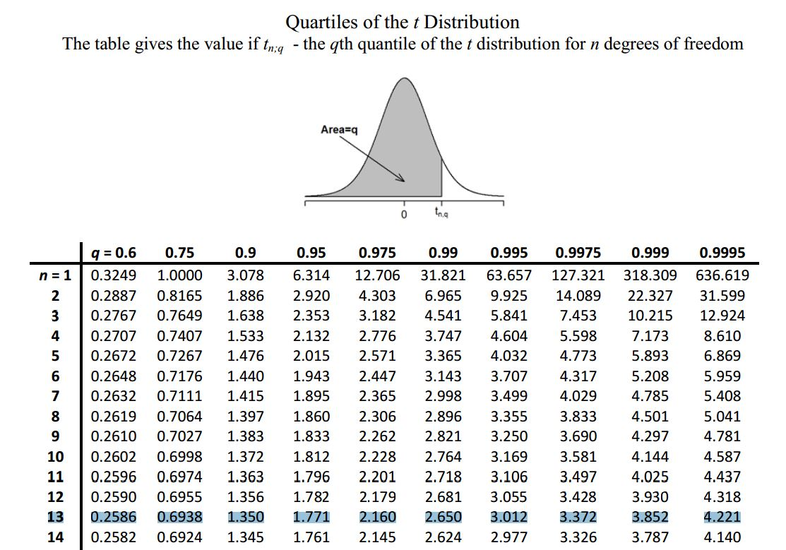
If you find this difficult, read Sullivan – Statistics Chapters 11.1, 11.2, 13.1, 13.2, 15.4

Slide 32
Other aspects of performance
Efficiency
Scalability
Robustness
Interpretability

Slide 33

Hyperparameter tuning
Optimizing a model

Slide 34
Parameters and hyperparameters
Difference?
Hyperparameters are set by the user
k-NN: k, distance_measure, …
Decision tree: max_depth, …
Parameters are optimized automatically when building the model
Decision tree: which split is made

Slide 35
What is hyperparameter tuning
Other names:
hyperparameter optimization
parameter tuning/optimization (not accurate!)
Goal:
find optimal hyperparameter settings
Compare:
parameter optimization = model training

Slide 36
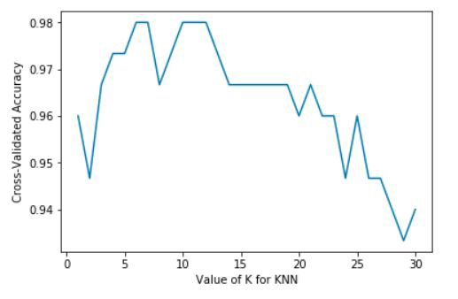
Example: optimizing k of k-NN
Source: https://medium.com/@svanillasun/how-to-deal-with-cross-validation-based-on-knn-algorithm-compute-auc-based-on-naive-bayes-ff4b8284cff4

Slide 37
Tuning one hyperparameter
List values to try
For each value measure performance (e.g. accuracy) in experiment
Use value that gives best performance

Slide 38
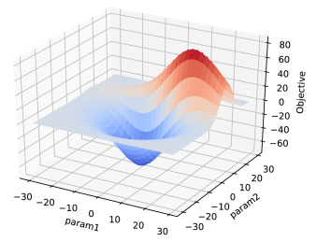
Tuning multiple hyperparameters
List hyperparameters
List values to try
List combinations to try
For each selected combination measure performance
Use combination that gives best performance
Source: https://www.groundai.com/project/lamvi-2-a-visual-tool-for-comparing-and-tuning-word-embedding-models/1

Slide 39
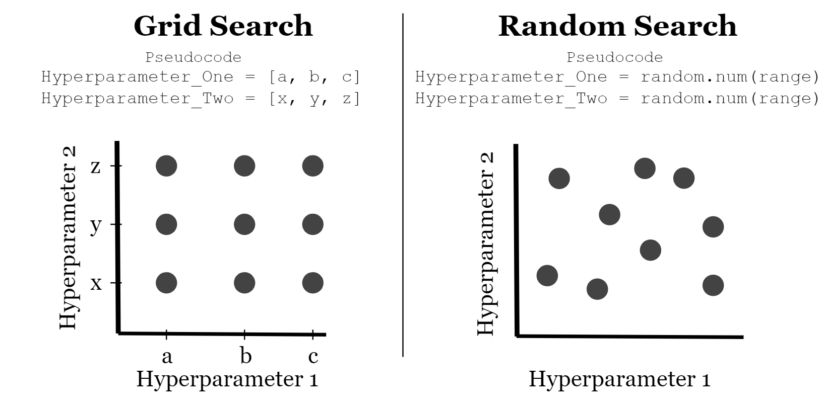
Combinations of values 1: grid search
Exhaustively try all combinations
n hyperparameters with m values:
m^{n} combinations

Slide 40
Combinations of values 2: random search
Try random combinations
Run until time is up or fixed number of combinations

Slide 41
Adding a validation set
Training set
built model for each hyperparameter value combination
Validation set
evaluate model for each hyperparameter value combination
Test set
evaluate final model
do not use until the very end! No tuning afterwards!
training set
validation set
test set

Slide 42
Training set – validation set – test set
train model on training set
Tweak hyperparameters according to results on validation set
Evaluate model on validation set
Evaluate final model on the test set

Slide 43
Training and validation set: k-fold cross-validation
Complete training+validation set (set apart from the test set)
x | x | x | x | x | x | x | x | x | x
Fold 1:
val | val | train | train | train | train | train | train | train | train
Fold 2:
train | train | val | val | train | train | train | train | train | train
Fold 3:
train | train | train | train | val | val | train | train | train | train
Fold 4:
train | train | train | train | train | train | val | val | train | train
Fold 5:
train | train | train | train | train | train | train | train | val | val
Average results over folds

Slide 44
And now…
Exercises part 3

